Slide 1
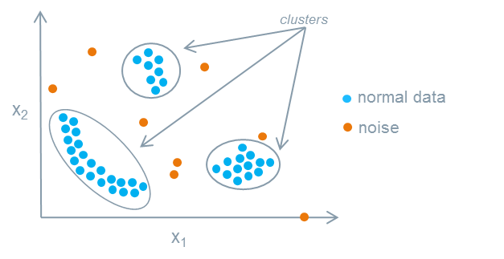
ANAMOLY DETECTION
Anomaly Detection is the technique of identifying rare events or observations which can raise suspicions by being statistically different from the rest of the observations. Such “anomalous” behaviour typically translates to some kind of a problem like a credit card fraud, failing machine in a server, a cyber attack, etc.
For instance, you are asked to remove the rotten tomatoes from bucket because if not separated it will also spoil the other good tomatoes.
Similarly, there are variable/features/data points which are of no use or making no difference but could be responsible for greater loss. Thus we need to find them and remove them for better accuracy.

Slide 2
An anomaly can be broadly categorized into three categories –
Point Anomaly: A data point is considered a global outlier if its value is far outside the entirety of the data set in which it is found (similar to how “global variables” in a computer program can be accessed by any function in the program).
Contextual Anomaly: A data point is considered a contextual outlier if its value significantly deviates from the rest the data points in the same context. Note that this means that same value may not be considered an outlier if it occurred in a different context.
Collective Anomaly: A subset of data points within a data set is considered anomalous if those values as a collection deviate significantly from the entire data set, but the values of the individual data points are not themselves anomalous in either a contextual or global sense.
Example - A plane landing on a highway is a global outlier because it’s a truly rare event that a plane would have to land there.
If the highway was congested with traffic that would be a contextual outlier if it was happening at 3 a.m. when traffic doesn’t usually start until later in the morning when people are heading to work.
And if every car on the hoghway was moving in wrong direction at the same time that would be a collective outlier because although it’s definitely not rare that people move in wrong direction, it is unusual that all cars would relocate at the same exact time.

Slide 3
Let’s move on to examples which are more specific to business:
A banking customer who normally deposits no more than $1000 a month in checks at a local ATM suddenly makes two cash deposits of $5000 each in the span of two weeks is a global anomaly because this event has never before occurred in this customer’s history. The time series data of their weekly deposits would show an abrupt recent spike. Such a drastic change would raise alarms as these large deposits could imply illicit commerce or money laundering.
A sudden surge in order volume at an eCommerce company, as seen in that company’s hourly total orders for example, could be a contextual outlier if this high volume occurs outside of a known promotional discount or high volume period like Black Friday. Could this stampede be due to a pricing glitch which is allowing customers to pay pennies on the dollar for a product?
A publicly traded company’s stock is never a static thing, even when prices are relatively stable and there isn’t an overall trend, and there are minute fluctuations over time. If the stock price remained at exactly the same price (to the penny) for an extended period of time, then that would be a collective outlier. In fact, this very thing occurred to not one, but several tech companies on July 3 of this year on the Nasdaq exchange when the stock prices for several companies – including tech giants Apple and Microsoft – were listed as $123.45.

Slide 4
Anomaly detection can be done using the concepts of Machine Learning.
It can be done in the following ways –
Supervised Anomaly Detection: This method requires a labeled dataset containing both normal and anomalous samples to construct a predictive model to classify future data points.
Unsupervised Anomaly Detection: This method does require any training data and instead assumes two things about the data ie Only a small percentage of data is anomalous and Any anomaly is statistically different from the normal samples. Based on the above assumptions, the data is then clustered using a similarity measure and the data points which are far off from the cluster are considered to be anomalies.

